Slide 1
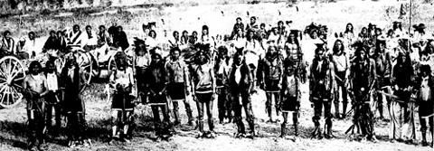
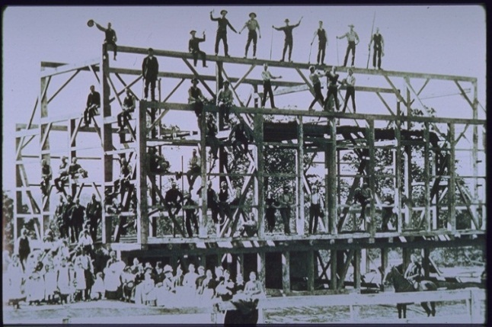
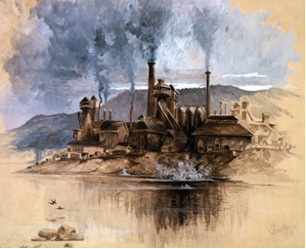
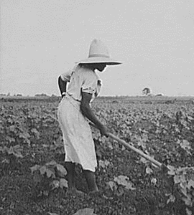
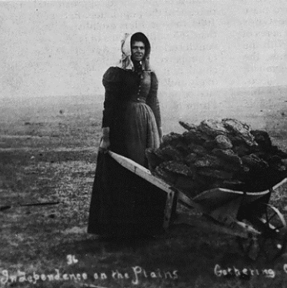
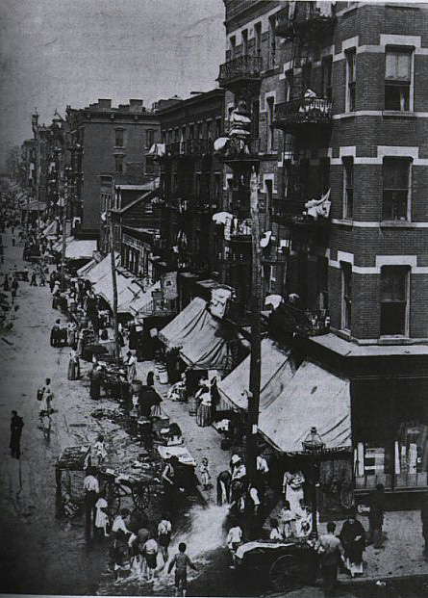
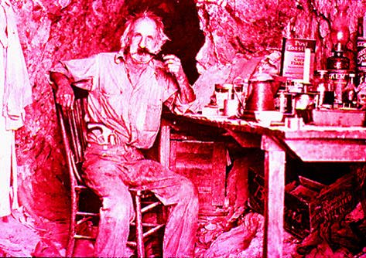
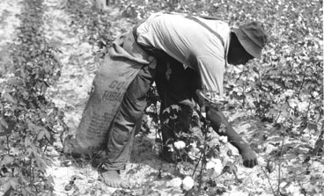
United States Since 1865
Professor: Jane Berger

Slide 2
On a blank piece of paper:
Name
Year in school
Where you’re from
Major
What helps you learn in class?
Is there anything I should know about you?
Identify one or more successful study habits that you will use in this class.
Identify at least one study habit you hope to develop or an obstacle to studying you hope to overcome. You will be asked about your success at meeting this goal at the end of the semester.

Slide 3
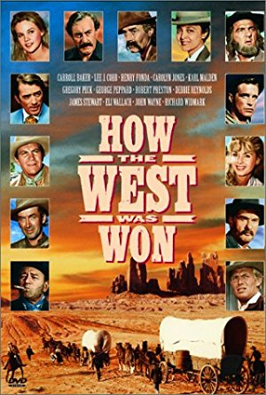

How Should We Approach the Study of History?

Slide 4
Whose History Are We Studying?
Whose history is reflected in the phrase “How the West was won”?
Whose history is reflected in the phrase “How the West was lost”?
Is one phrase correct? Why or why not? What should history textbooks say?
What does the following expression mean: “History is written by the victors”?
Should historians try to avoid writing only the history of victors? Why or why not?
When I tell the history of non-victors, students sometimes say I’m harping on the negatives. What should I do about that?

Slide 5
History and “Fake News”
Do you trust the information in the history textbook for this? Why and/or why not?
Should you trust the history I will tell you during our classes? Why and/or why not?
How do historians back up the assertions that they make? What is their proof?
There is incontrovertible evidence that the Holocaust (the murder of about 6 million Jews and others during World War II) happened. Why do you think some people do not believe it happened?
What is the danger of people not believing in historical events?
What standard do you use to decide if something written about history is true?

Slide 6
History at Moravian
How do you think college-level history courses differ from high school-level history courses?
When you are confronted with a primary source (a document, picture, artifact, etc. from the past), how can you approach it as a critical thinker? What questions should you ask?
If you have a hypothesis about the meaning of a primary source, how might you go about testing it?

Slide 7

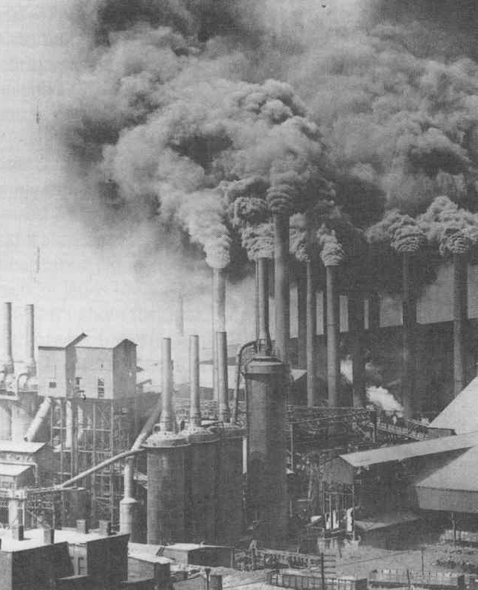
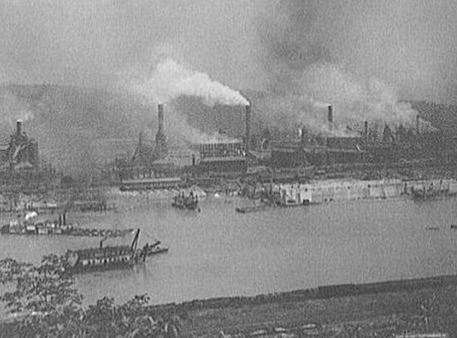
The Industrial System in the Late Nineteenth-Century United States
Why do historians think about the ways societies organize their economies?

Slide 8
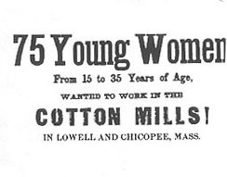
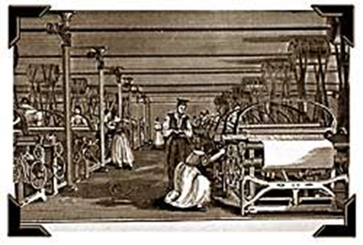

The Industrial Revolution in the U.S.
The first industrial system
1810-1870
The second industrial system
1870-1910s
Note: This course begins at the transition.

Slide 9

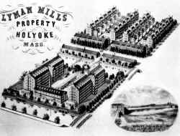
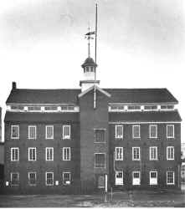
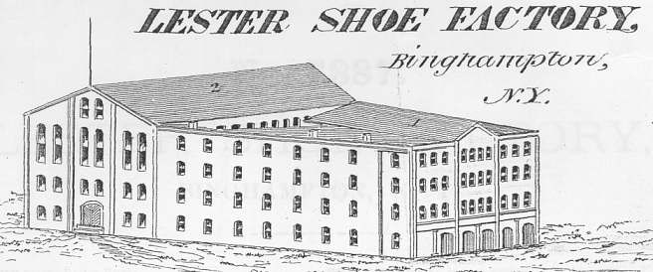
The first industrial system
American Revolution: regional economic systems
Earliest industry: textiles
* mass production
* mechanization
* unskilled workers

Slide 10
What Was Life Like for Workers During the First Industrial System?
Imagine how shoes were made before industrialization. Where were they made? What did that place probably look like? What kind of equipment/tools were involved? Who was probably making them? How did he/she learn how to make shoes? If people worked together in the shoe-making business, what were the relationships between them probably like? Where might the shoes have been sold?
Then imagine how shoes were made after industrialization and answer the above questions.
What are the differences, and how would they impact people?

Slide 11
What Was the Next Big Thing?
As the first industrial system was underway in the U.S., a group of entrepreneurs started thinking about how to make their mark on American society. They wanted to come up with the next big things that could not only advance the America economy but shoot them to the top of the economic ladder.
If you were among them, what do you think the next big things could have been?

Slide 12
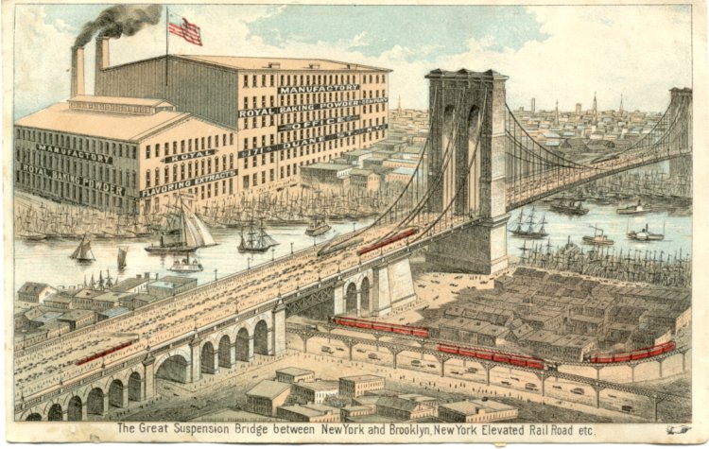
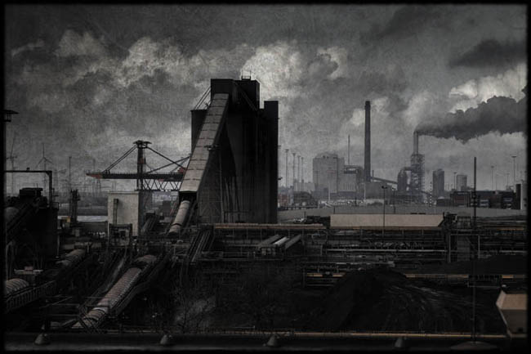
The Second Industrial System and the Rise of Corporate Capitalism
“Producers’ Goods”
  Heavy Industries
  Steel, iron, petroleum, and machinery
Concentration of capital allowed for huge, innovative projects.

Slide 13
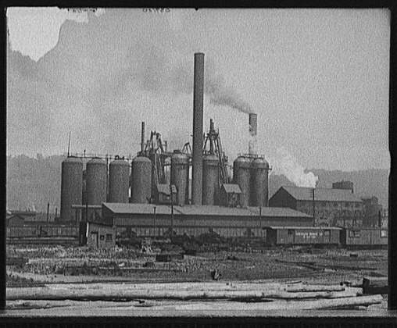
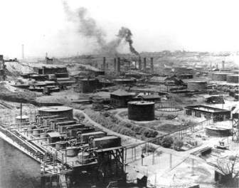
The second industrial system
Providing goods and services necessary for maintaining the industrial system
Using the logic of the first industrial system
* mass production, mechanization, unskilled workers
Premise: maximize profits
“Watch the cost!”
-Andrew Carnegie

Slide 14
What was the Second Industrial System?
How might working in a shoe factory differ from working in a large steel mill?
Describe the relationship between the owners of shoe factories and the owners of steel mills.

Slide 15
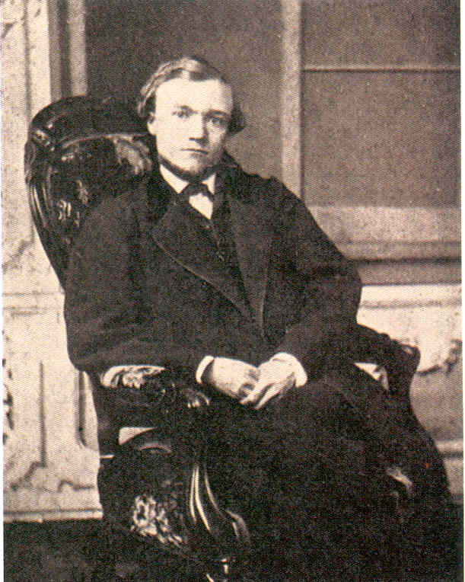

Monopolies and Concentrated Wealth
Vertical integration
Control production at every step, from raw materials through processing to transport and merchandising
Carnegie Steel (1872)
By 1900, earned $40 million/year

Slide 16
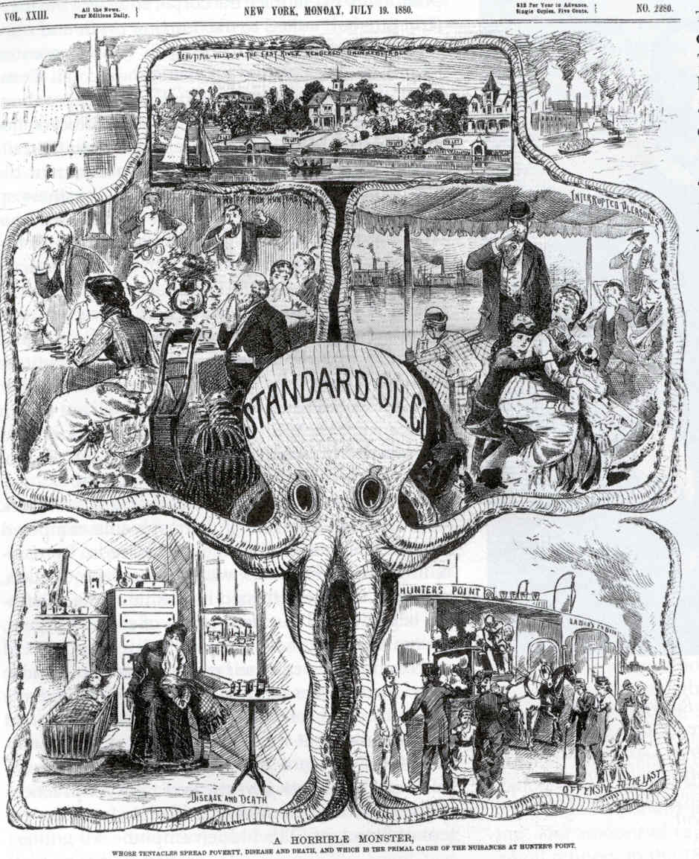
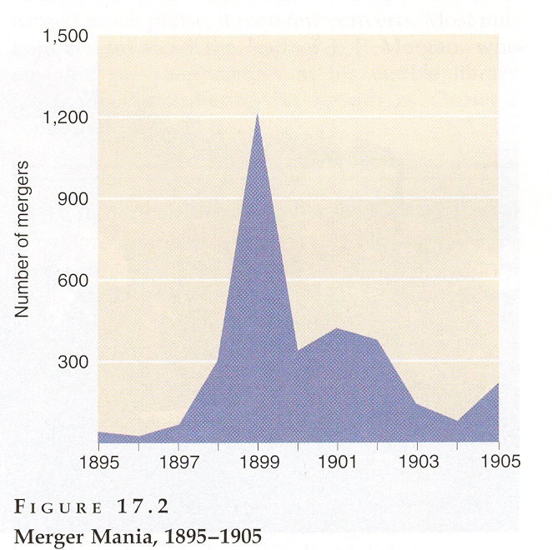
Monopolies and Concentrated Wealth
Horizontal Integration
gain control of the market for a single product
Standard Oil and John D. Rockefeller
  controlled 90% of the nation’s oil-refining industry
1898-1902: 2,600 firms disappeared

Slide 17
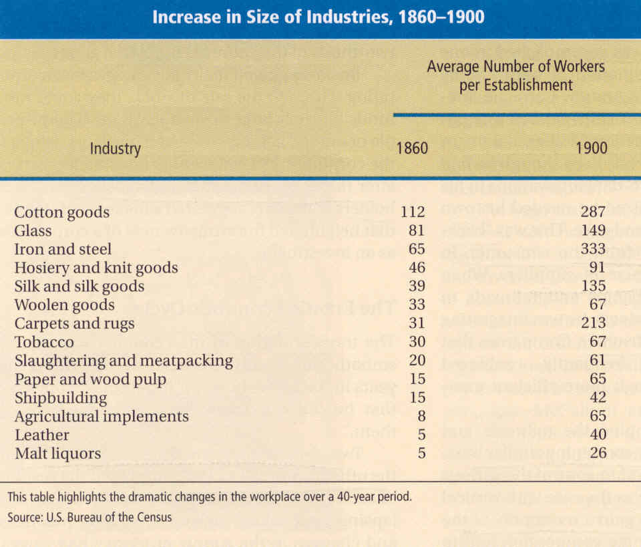
Job Creation and Economic Growth
By 1900, more than 1,000 factories had labor forces between 500-1000
450 businesses had more than 1,000 workers

Slide 18
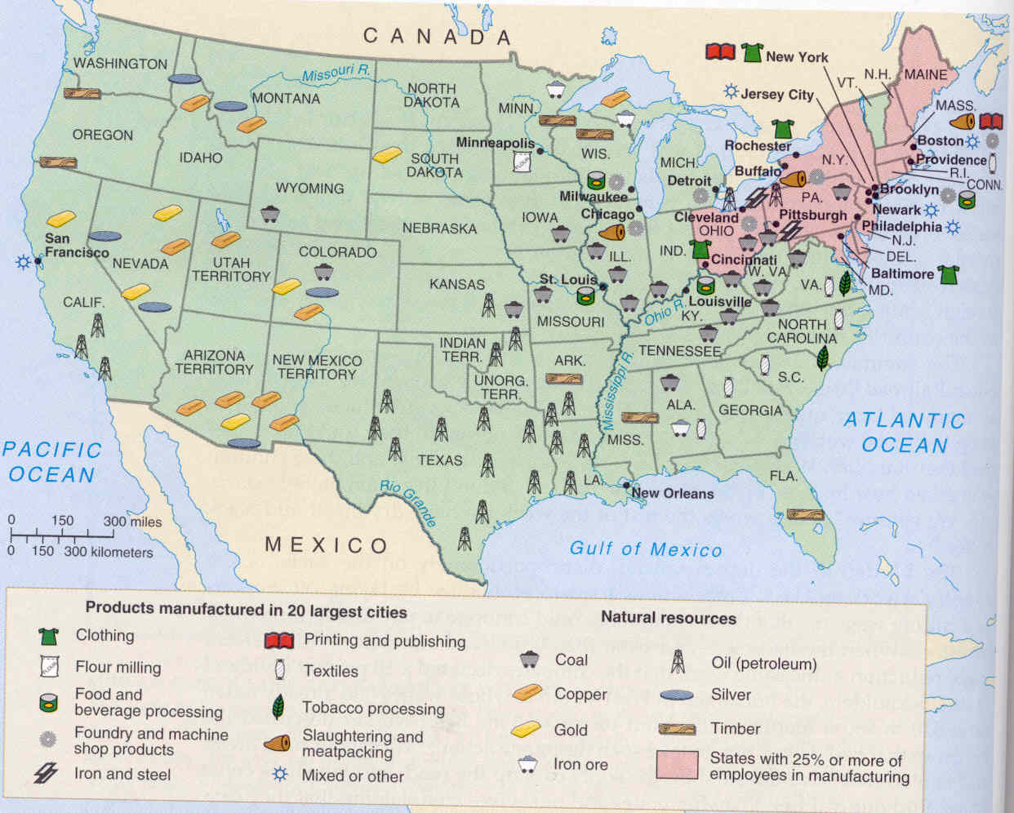
Incorporation of the Economy
U.S. 1st in productivity 1865 - $2 billion; 1900 - $13 billion
  manufacturing 1/3 of world's goods

Slide 19
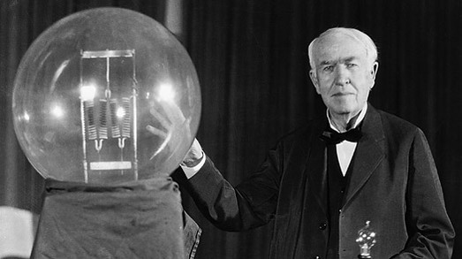
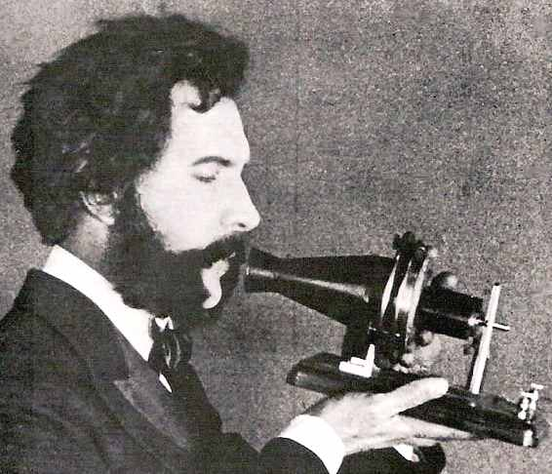
The Age of Inventions
1870-1910: 900,000 patents
The age of electricity -
  Edison perfected the light bulb (1879)
Telephone (1876)
  Alexander Graham Bell
  310,000 phones in 1895 to over 1.5 million by 1900
Appliances
Ready-made food
Steam engine, electric trolleys

Slide 20
The Rewards of the Second Industrial System
Technology
Innovation
Productivity
Rags to riches stories

Slide 21
Downsides of the System
What are some of the problems and conflicts produced by this system?
Bonus Question: Industrialization and mechanization revolutionized the American economy during the late nineteenth and early twentieth centuries. What if revolutionizing American society today?

Slide 22
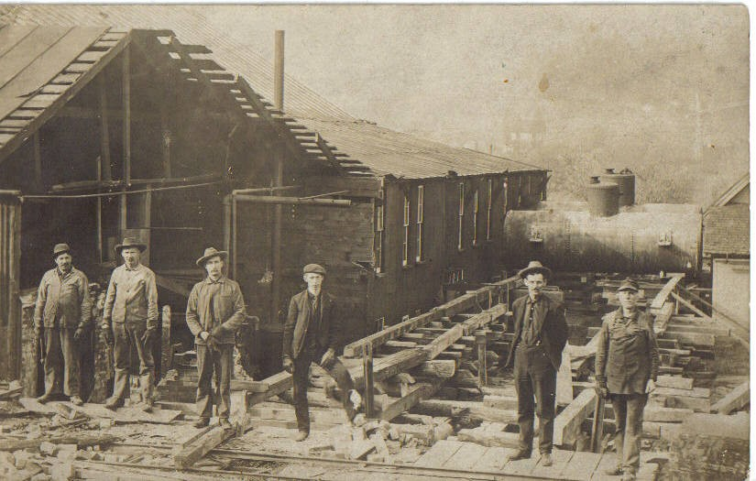

The consequences of maximizing profit:
Fixed and variable costs
* squeezing labor
Monopolies
  * squeezing farmers

Slide 23
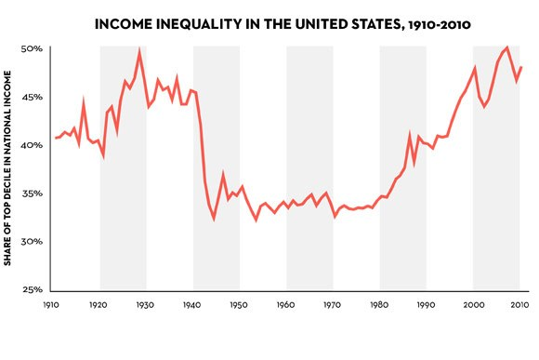
Distribution of Wealth

Slide 24
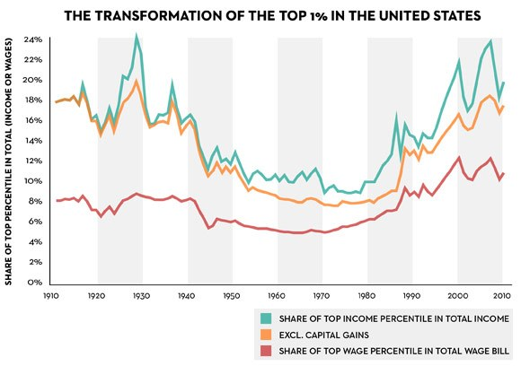
Distribution of Wealth: Top 1%

Slide 25
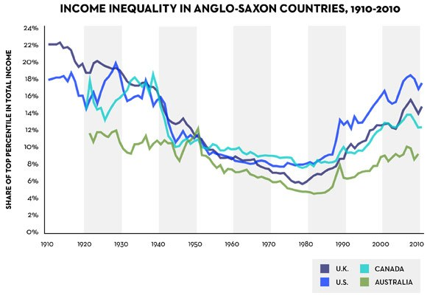
Income Inequality-”Anglo-Saxon” Nations

Slide 26
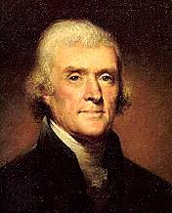
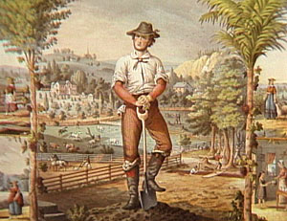
Threat to democracy?
republican virtue
A nation of yeomen farmers?
Contradiction with the ideas driving the first industrial system?

Slide 27
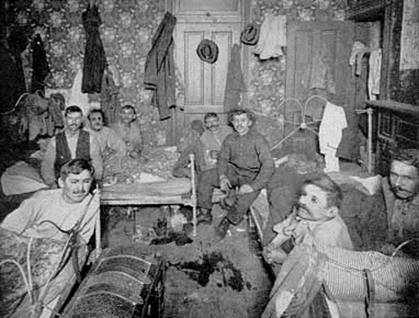
Question for next time:
How were working-class Americans and immigrants feeling about the industrial system?
?

